Slide 1
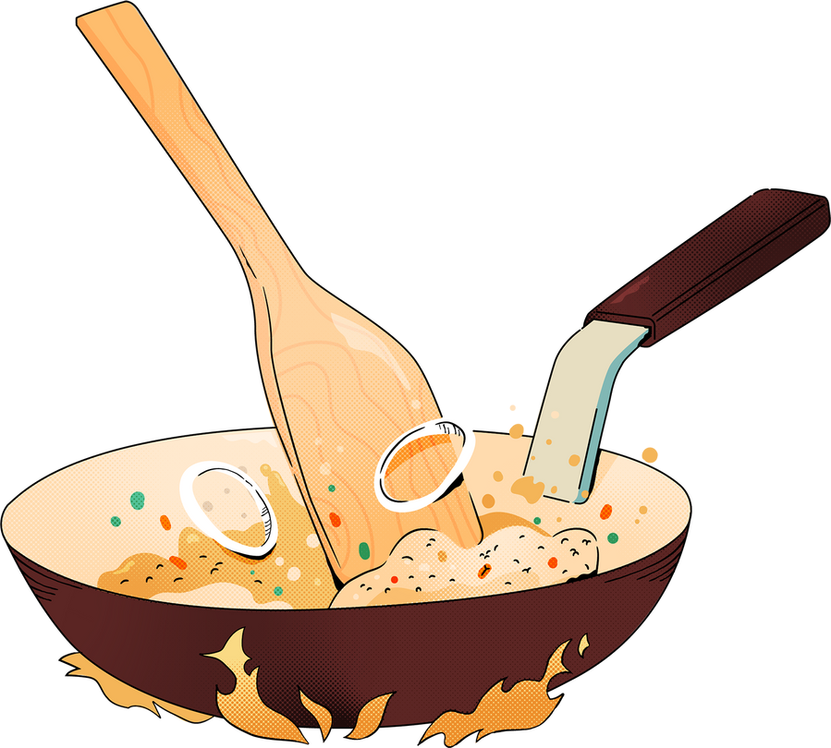
FOOD MADE WITH LOVE
01

Slide 2
WELCOME EVERYONE
02

Slide 3
GROUP MEMBERS
S. NO. | NAME | ROLL NO. | CLASS
01 | NESCHAL SINGH | 2201641530107 | ELITE-II
02 | PRANAV GUPTA | 2201641530124 | ELITE-II
03 | PRIYANSHU PANDEY | 2201641530127 | CS-AIML-2B
04 | PANKAJ SINGH KUSHWAHA | 2201641530112 | ELITE-II
C CNCNVHH,

Slide 4
03
BACHELORS,PG, WORKING PEOPLE ARE NOT ABLE TO GET THE TASTE OF GHAR KA KHANA
NOT ABLE TO GET NUTRITIOUS FOOD
THE PROBLEM

Slide 5




FOOD MADE WITH LOVE
04

Slide 6

THE IDEA
PROVIDING NUTRITIOUS ,HYGENIC MEALS CONTAINING THE RIGHT AMOUNT OF SPICES AND VEGETABLES ,DELIVERED AT YOUR DOORSTEPS DIRECTLY FROM OUR FOOD PARTNERS ,THE HOUSEWIVES.
05

Slide 7


Company Vision And Mission
VISION
EVERY TIME SOMEONE CRAVE FOR GHAR KA KHANA, THEY SHOULD REMEMBER US. WE ARE A TECH COMPANY THAT CONNECTS THE PHYSICAL AND DIGITAL WORLDS TO HELP MAKE THE FOOD EXPERIENCE BETTER. BECAUSE WE BELIEVE EVERYONE DESERVE AT LEAST ONE GREAT MEAL IN A DAY.
MISSION
PROVIDING BETTER FOOD FOR EVERYONE. EMPOWERING WOMEN
06

Slide 8
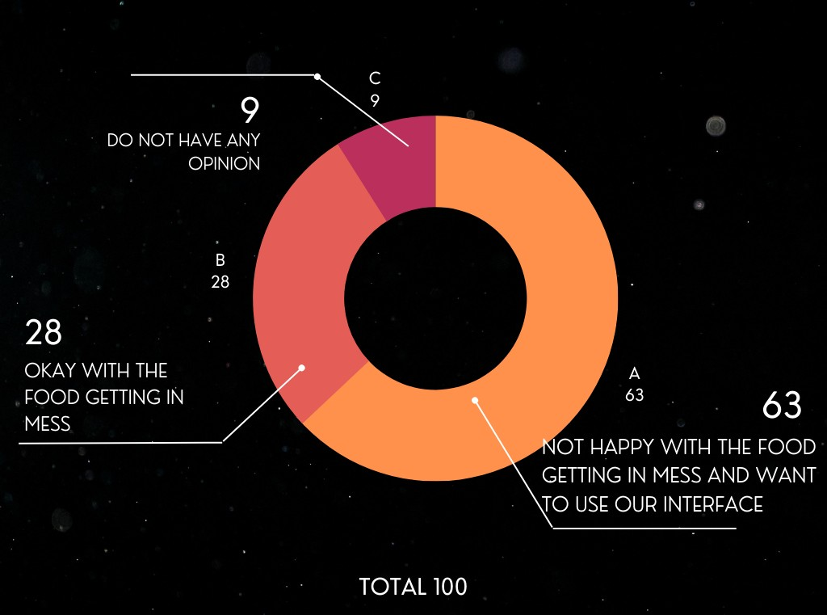
07
STATISTICS
SURVEY CONDUCTED IN HOSTEL C, PSIT

Slide 9
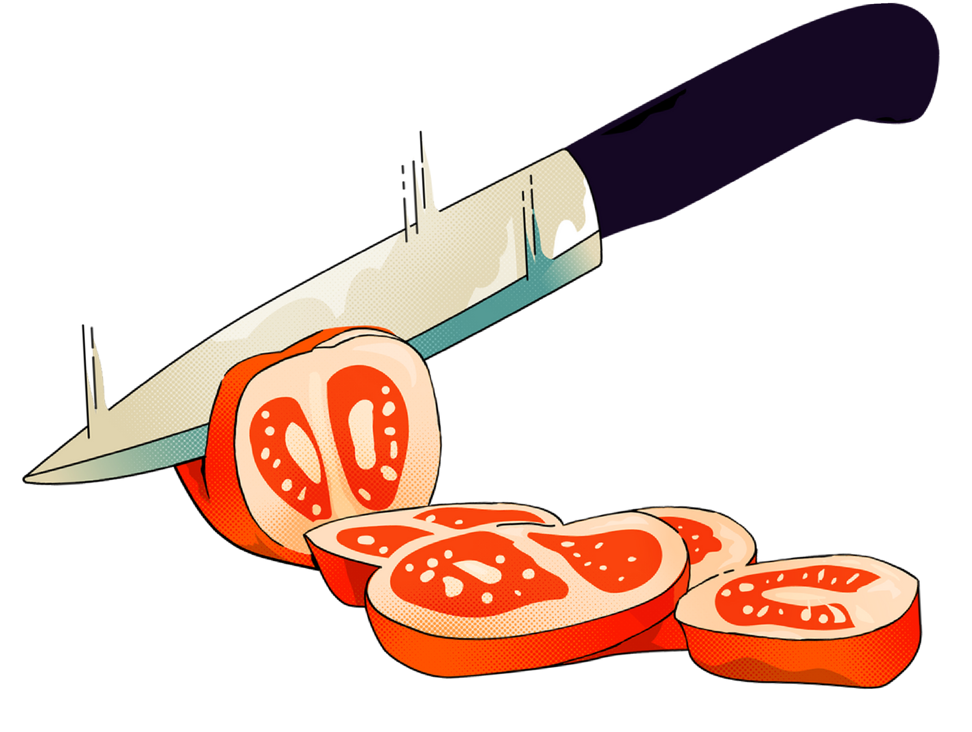







NOT A FAST FOOD COMPANY
FOOD STATIONS WITHIN 1.5 KM FROM YOUR HOME
STANDARD MEAL AS WELL AS CUSTOMIZED MEAL AVAILABLE FOOD PARTNER
ALLOWED TO SERVE ONLY
10 ORDERS PER DAY
08
08

Slide 10
HARDWARE REQUIREMENTS:
1. CPU (Central Processing Unit):- A multi-core processor, such as an Intel Core i5 or AMD Ryzen 5, is often sufficient for development work
2. RAM (Random Access Memory):- A minimum of 8GB of RAM is usually recommended for software development. More RAM, such as 16GB or 32GB, can significantly improve performance.
3. GPU (Graphics Processing Unit):- Integrated graphics on modern CPUs are often sufficient.
4. HDD (Hard Disk Drive) or SSD (Solid-State Drive):- An SSD of 256 GB is enough for the initial phase. As the time goes, we might need a bigger storage.

Slide 11
SOFTWARE REQUIREMENTS:
1. Operating System (OS):- Windows.
2. Integrated Development Environment (IDE):- Visual Studio Code or JetBrains WebStorm.
3. Version Control Software:- GitHub, GitLab.
4. Programming Languages and Runtimes:- Python, JavaScript, and Java.
5. Web Development Tools:- Node.js, NPM (Node Package Manager React.
6. Database Management System (DBMS):- MySQL, MongoDB.

Slide 12

THANK YOU
09

